Slide 1
Unit III

Slide 2
Syllabus
Security in networks: Threats and Vulnerabilities, IP Security – Overview, Architecture etc., Email Security – PGP, S/MIME; Web Security – Requirements, Security Protocols like SSL, TLS, SET; Firewalls.

Slide 3
IP Security - IPSec - Covered
E-mail Security(PGP,S/MIME)
Web Security(SET, SSL,TLS)

Slide 4
IP Security
Internet Protocol Security (IPSec) is an open-source protocol framework for security development within the TCP/IP family of protocol standards.
It is used to secure communications across IP-based networks such as LANs, WANs, and the Internet.
The protocol is designed to protect data integrity, user confidentiality, and authenticity at the IP packet level.

Slide 5
Contd…
IP-level security encompasses three functional areas: authentication, confidentiality, and key management.
The authentication mechanism assures that a received packet was, in fact, transmitted by the party identified as the source in the packet header. In addition, this mechanism assures that the packet has not been altered in transit.
The confidentiality facility enables communicating nodes to encrypt messages to prevent eavesdropping by third parties.
The key management facility is concerned with the secure exchange of keys.

Slide 6
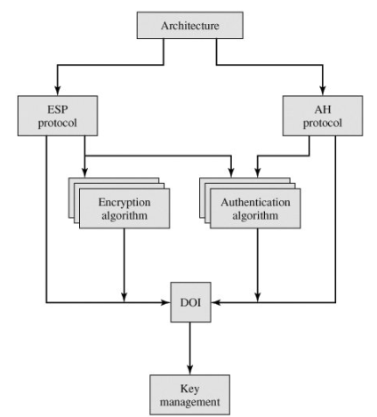
IPSec Documents

Slide 7
IPSec Services
The services are:
Access control
Connectionless integrity
Data origin authentication
Rejection of replayed packets (a form of partial sequence integrity) - Duplicate
Confidentiality (encryption)
Limited traffic flow confidentiality

Slide 8
Protocols
The application header (AH) protocol provides system-to-system authentication and data integrity verification, but does not provide secrecy for the content of a network communication.
The encapsulating security payload (ESP) protocol provides secrecy for the contents of network communications as well as system-to-system authentication and data integrity verification.

Slide 9
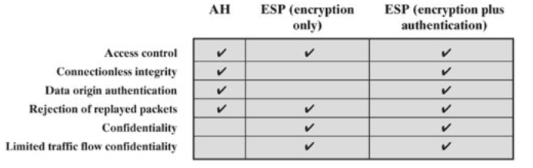

Slide 10
Modes
IPSec operates in two modes: transport and tunnel.
In transport mode only the IP data are encrypted, not the IP headers. This allows intermediate nodes to read the source and destination addresses.
In tunnel mode the entire IP packet(Data as well as Header) is encrypted and is then placed into the content portion of another IP packet. This requires other systems at the beginning and end of the tunnel to act as proxies and to send and receive the encrypted packets.

Slide 11
Security Association
Agreement between the sender and receiver
IP Sec - VPN - Private -
C and S - (Parameters) SA Database(SAD)
est- Connect
tra
ter

Slide 12
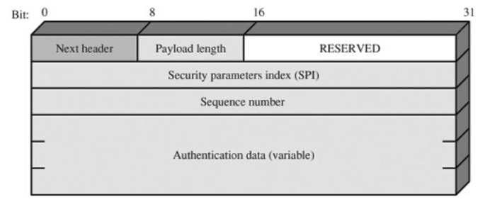
AH Format

Slide 13
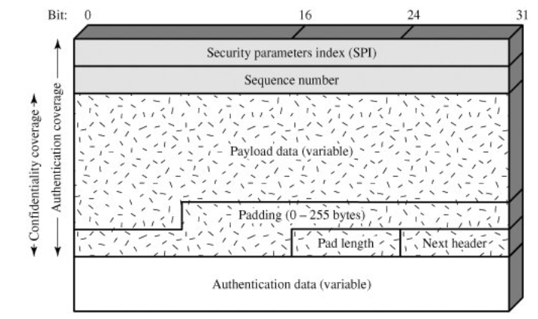
ESP Format

Slide 14
Security Parameters Index (32 bits): Identifies a security association.
Sequence Number (32 bits): A monotonically increasing counter value; this provides an anti-replay function, as discussed for AH.
Payload Data (variable): This is a transport-level segment (transport mode) or IP packet (tunnel mode) that is protected by encryption.

Slide 15
Padding (0-255 bytes): The purpose of this field is discussed later. for block
Pad Length (8 bits): Indicates the number of pad bytes immediately preceding this field.
Next Header (8 bits): Identifies the type of data contained in the payload data field by identifying the first header in that payload (for example, an extension header in IPv6, or an upper-layer protocol such as TCP).
Authentication Data (variable): A variable length field (must be an integral number of 32-bit words) that contains the Integrity Check Value computed over the ESP packet minus the Authentication Data field.

Slide 16
Key Management
The key management portion of IPSec involves the determination and distribution of secret keys.
A typical requirement is four keys for communication between two applications: transmit and receive pairs for both AH and ESP.
The IPSec Architecture document mandates support for two types of key management:
1. Manual: A system administrator manually configures each system with its own keys and with the keys of other communicating systems. This is practical for small, relatively static environments.
2. Automated: An automated system enables the on-demand creation of keys for SAs and facilitates the use of keys in a large distributed system with an evolving configuration. The default automated key management protocol for IPSec is referred to as ISAKMP/Oakley.

Slide 17
E-mail Security
E-mail security – PGP and S/MIME
PGP is an open-source freely available software package for e-mail security.
It provides authentication through the use of digital signature; confidentiality through the use of symmetric block encryption; compression using the ZIP algorithm; e-mail compatibility using the radix-64 encoding scheme; and segmentation and reassembly to accommodate long e-mails.

Slide 18
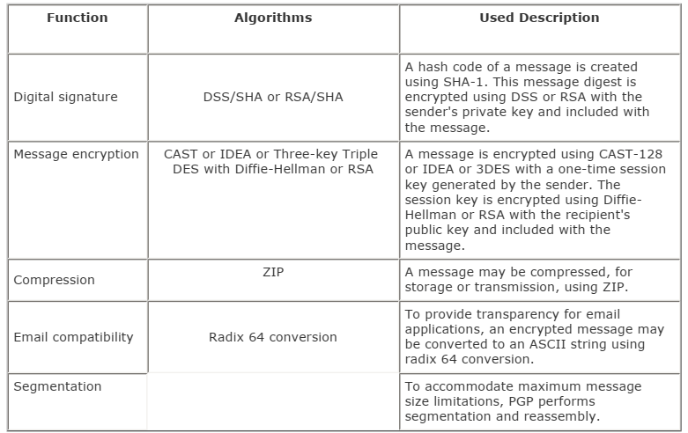

Slide 19
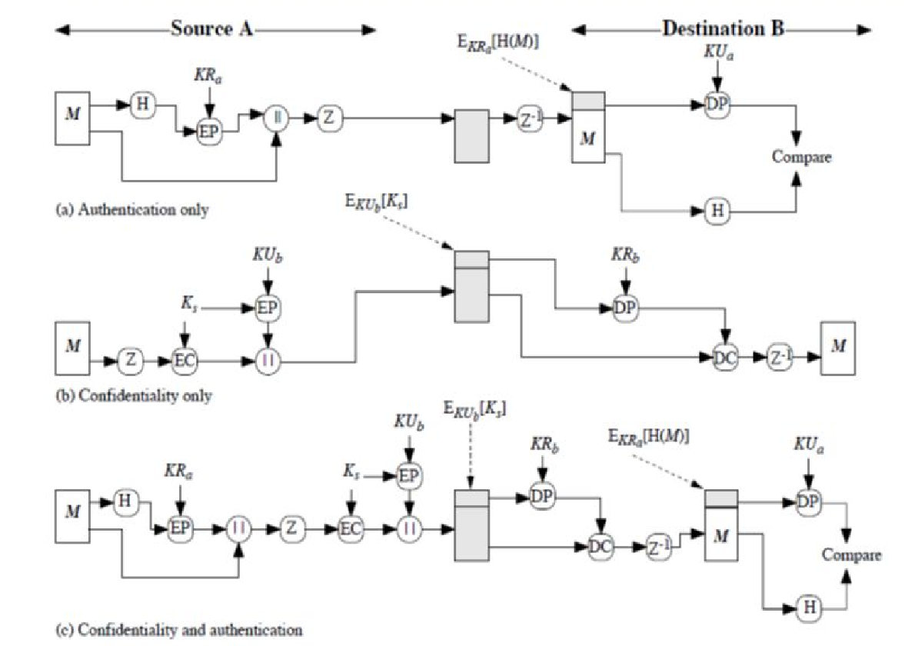

Slide 20
MIME
Multipurpose Internet Mail Extensions
MIME is intended to address some of the problems and limitations of the use of SMTP (Simple Mail Transfer Protocol) or some other mail transfer protocol.

Slide 21
Limitation of SMTP
SMTP cannot transmit executable files or other binary objects.
SMTP cannot transmit text data that includes national language characters.
SMTP servers may reject mail message over a certain size.
SMTP not support the transfer of video, images and audio files.

Slide 22
The MIME specification includes the following elements: 1. Five new message header fields are defined, which may be included in an RFC 822 header. These fields provide information about the body of the message. 2. A number of content formats are defined, thus standardizing representations that support multimedia electronic mail.
3. Transfer encodings are defined that enable the conversion of any content format into a form that is protected from alteration by the mail system.

Slide 23
MIME Header
The five header fields defined in MIME are as follows: 1. MIME-Version: Must have the parameter value 1.0. This field indicates that the message conforms to RFCs 2045 and 2046.
2. Content-Type: Describes the data contained in the body with sufficient detail that the receiving user agent can pick an appropriate agent or mechanism to represent the data to the user or otherwise deal with the data in an appropriate manner. text, html,audio, video, image, Table
3. Content-Transfer-Encoding: Indicates the type of transformation that has been used to represent the body of the message in a way that is acceptable for mail transport.
4. Content-ID: Used to identify MIME entities uniquely in multiple contexts.
5. Content-Description: A text description of the object with the body; this is useful when the object is not readable (e.g., audio data).

Slide 24
S/MIME
S/MIME (Secure/Multipurpose Internet Mail Extension) is a security enhancement to the MIME Internet email format standard, based on technology from RSA Data Security.
Although both PGP and S/MIME are on an IETF standards track, it appears likely that S/MIME will emerge as the industry standard for commercial and organizational use, while PGP will remain the choice for personal e-mail security for many users.

Slide 25
S/MIME Functionality
In terms of general functionality, S/MIME is very similar to PGP. Both offer the ability to sign and/or encrypt messages.
S/MIME provides the following functions:
1. Enveloped data: This consists of encrypted content of any type and encrypted-content encryption keys for one or more recipients.
2. Signed data: A digital signature is formed by taking the message digest of the content to be signed and then encrypting that with the private key of the signer. The content plus signature are then encoded using base64 encoding. A signed data message can only be viewed by a recipient with S/MIME capability.
3. Clear-signed data: As with signed data, a digital signature of the content is formed. However, in this case, only the digital signature is encoded using base64. As a result, recipients without S/MIME capability can view the message content, although they cannot verify the signature.
4. Signed and enveloped data: Signed-only and encrypted-only entities may be nested, so that encrypted data may be signed and signed data or clear-signed data may be encrypted.

Slide 26
S/MIME uses the following terminology, taken from RFC 2119 to specify the requirement level:
1. MUST: The definition is an absolute requirement of the specification. An implementation must include this feature or function to be in conformance with the specification.
2. SHOULD: There may exist valid reasons in particular circumstances to ignore this feature or function, but it is recommended that an implementation include the feature or function.

Slide 27
S/MIME incorporates three public-key algorithms. The Digital Signature Standard (DSS) is the preferred algorithm for digital signature.
S/MIME lists Diffie-Hellman as the preferred algorithm for encrypting session keys; in fact, S/MIME uses a variant of Diffie-Hellman that does provide encryption/decryption, known as ElGamal. As an alternative, RSA, can be used for both signatures and session key encryption. For the hash function used to create the digital signature, the specification requires the 160-bit SHA-1 but recommends receiver support for the 128-bit MD5 for backward compatibility with older versions of S/MIME.
For message encryption, three-key triple DES (tripleDES) is recommended, but compliant implementations must support 40-bit RC2.
S/MIME uses public-key certificates that conform to version 3 of X.509.

Slide 28
Web Security
Secure Socket Layer (SSL) provide security to the data that is transferred between web browser and server.
SSL encrypt the link between a web server and a browser which ensures that all data passed between them remain private and free from attack.
SSL is designed to make use of TCP to provide a reliable end-to-end secure service.

Slide 29
Secure Socket Layer Protocols
SSL record protocol
Handshake protocol
Change-cipher spec protocol
Alert protocol

Slide 30
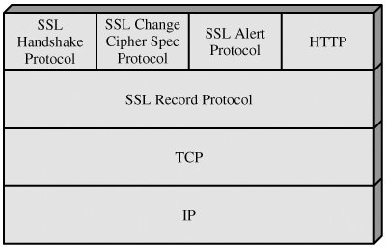
SSL Protocol Stack

Slide 31
Two important SSL concepts are the SSL session and the SSL connection, which are defined in the specification as follows:
Connection: A connection is a transport (in the OSI layering model definition) that provides a suitable type of service. For SSL, such connections are peer-to-peer relationships. The connections are transient. Every connection is associated with one session.
Session: An SSL session is an association between a client and a server. Sessions are created by the Handshake Protocol. Sessions define a set of cryptographic security parameters, which can be shared among multiple connections. Sessions are used to avoid the expensive negotiation of new security parameters for each connection.

Slide 32
SSL Record Protocol
The SSL Record Protocol provides two services for SSL connections:
Confidentiality: The Handshake Protocol defines a shared secret key that is used for conventional encryption of SSL payloads.
Message Integrity: The Handshake Protocol also defines a shared secret key that is used to form a message authentication code (MAC).

Slide 33
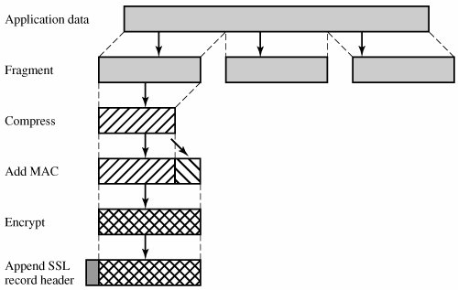
The Record Protocol takes an application message to be transmitted, fragments the data into manageable blocks, optionally compresses the data, applies a MAC, encrypts, adds a header, and transmits the resulting unit in a TCP segment. Received data are decrypted, verified, decompressed, and reassembled and then delivered to higher-level users.

Slide 34
The final step of SSL Record Protocol processing is to prepend a header, consisting of the following fields:
Content Type (8 bits): The higher layer protocol used to process the enclosed fragment.
Major Version (8 bits): Indicates major version of SSL in use. For SSLv3, the value is 3.
Minor Version (8 bits): Indicates minor version in use. For SSLv3, the value is 0.
Compressed Length (16 bits): The length in bytes of the plaintext fragment (or compressed fragment if compression is used). The maximum value is 2¹⁴ + 2048.

Slide 35
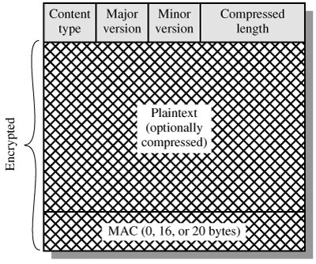

Slide 36
Change Cipher Spec Protocol
The Change Cipher Spec Protocol is one of the three SSL-specific protocols that use the SSL Record Protocol, and it is the simplest. This protocol consists of a single message, which consists of a single byte with the value 1. The sole purpose of this message is to cause the pending state to be copied into the current state, which updates the cipher suite to be used on this connection.

Slide 37
Alert Protocol
The Alert Protocol is used to convey SSL-related alerts to the peer entity. As with other applications that use SSL, alert messages are compressed and encrypted, as specified by the current state.
Each message in this protocol consists of two bytes.
The first byte takes the value warning(1) or fatal(2) to convey the severity of the message.
If the level is fatal, SSL immediately terminates the connection. Other connections on the same session may continue, but no new connections on this session may be established.
The second byte contains a code that indicates the specific alert.

Slide 38
First, we list those alerts that are always fatal (definitions from the SSL specification):
unexpected_message: An inappropriate message was received. bad_record_mac: An incorrect MAC was received.
decompression_failure: The decompression function received improper input (e.g., unable to decompress or decompress to greater than maximum allowable length).
handshake_failure: Sender was unable to negotiate an acceptable set of security parameters given the options available.
illegal_parameter: A field in a handshake message was out of range or inconsistent with other fields.

Slide 39
The remainder of the alerts are the following:
close_notify: Notifies the recipient that the sender will not send any more messages on this connection. Each party is required to send a close_notify alert before closing the write side of a connection.
no_certificate: May be sent in response to a certificate request if no appropriate certificate is available.
bad_certificate: A received certificate was corrupt (e.g., contained a signature that did notverify).
unsupported_certificate: The type of the received certificate is not supported.
certificate_revoked: A certificate has been revoked by its signer.
certificate_expired: A certificate has expired.
certificate_unknown: Some other unspecified issue arose in processing the certificate, rendering it unacceptable.

Slide 40
Handshake Protocol
This protocol allows the server and client to authenticate each other and to negotiate an encryption and MAC algorithm and cryptographic keys to be used to protect data sent in an SSL record.
The Handshake Protocol is used before any application data is transmitted.

Slide 41
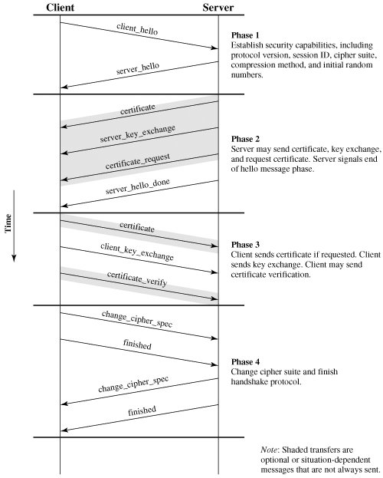

Slide 42
TLS
TLS means Transport Layer Security, which is a cryptographic protocol successor of SSL 3.0.
Cipher suites:
SSL protocol offers support for Fortezza cipher suite. TLS does not offer support. TLS follows a better standardization process that makes defining of new cipher suites easier like RC4, Triple DES, AES, IDEA, etc.
Alert messages:
SSL has the “No certificate” alert message. TLS protocol removes the alert message and replaces it with several other alert messages.
Record Protocol:
SSL uses Message Authentication Code (MAC) after encrypting each message while TLS on the other hand uses HMAC — a hash-based message authentication code after each message encryption.
Handshake process:
In SSL, the hash calculation also comprises the master secret and pad while in TLS, the hashes are calculated over handshake message.
Message Authentication:
SSL message authentication adjoins the key details and application data in ad-hoc way while TLS version relies on HMAC Hash-based Message Authentication Code.

Slide 43
SET
SET is an open encryption and security specification designed to protect credit card transactions on the Internet. SET provides three services:
1. Provides a secure communications channel among all parties involved in a transaction.
2. Provides trust by the use of X.509v3 digital certificates.
3. Ensures privacy because the information is only available to parties in a transaction when and where necessary.

Slide 44
SET incorporates the following features: 1. Confidentiality of information
2. Integrity of data 3. Cardholder account authentication 4. Merchant authentication

Slide 45
SET Participants
Cardholder: A cardholder is an authorized holder of a payment card (e.g., MasterCard, Visa) that has been issued by an issuer.
Merchant: A merchant is a person or organization that has goods or services to sell to the cardholder. Typically, these goods and services are offered via a Web site or by electronic mail.
Issuer: This is a financial institution, such as a bank, that provides the cardholder with the payment card.
Acquirer: This is a financial institution that establishes an account with a merchant and processes payment card authorizations and payments. Merchants will usually accept more than one credit card brand but do not want to deal with multiple bankcard associations or with multiple individual issuers. The acquirer provides authorization to the merchant that a given card account is active and that the proposed purchase does not exceed the credit limit. The acquirer also provides electronic transfer of payments to the merchant's account. Subsequently, the acquirer is reimbursed by the issuer over some sort of payment network for electronic funds transfer.

Slide 46
5. Payment gateway: This is a function operated by the acquirer or a designated third party that processes merchant payment messages. The payment gateway interfaces between SET and the existing bankcard payment networks for authorization and payment functions. The merchant exchanges SET messages with the payment gateway over the Internet, while the payment gateway has some direct or network connection to the acquirer's financial processing system.
6. Certification authority (CA): This is an entity that is trusted to issue X.509v3 public-key certificates for cardholders, merchants, and payment gateways. The success of SET will depend on the existence of a CA infrastructure available for this purpose. As was discussed in previous chapters, a hierarchy of CAs is used, so that participants need not be directly certified by a root authority.

Slide 47
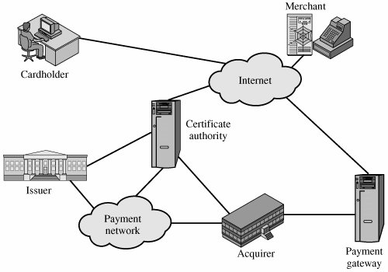

Slide 48
Dual Signature
The purpose of the dual signature is to link two messages that are intended for two different recipients.
In this case, the customer wants to send the order information (OI) to the merchant and the payment information (PI) to the bank.
The merchant does not need to know the customer's credit card number, and the bank does not need to know the details of the customer's order.
The customer is afforded extra protection in terms of privacy by keeping these two items separate.
However, the two items must be linked in a way that can be used to resolve disputes if necessary.
The link is needed so that the customer can prove that this payment is intended for this order and not for some other goods or service.

Slide 49
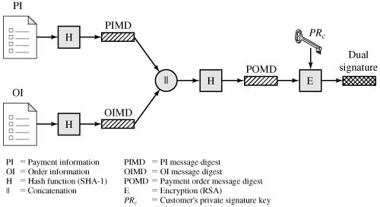
Construction of Dual Signature

Slide 50
Payment Processing
Purchase request: Message from customer to merchant containing OI for merchant and PI for bank. Payment authorization: Exchange between merchant and payment gateway to authorize a given amount for a purchase on a given credit card account.
Payment capture: Allows the merchant to request payment from the payment gateway.

Slide 51
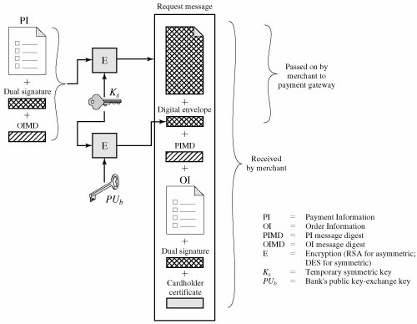
Cardholder Sends Purchase Request

Slide 52
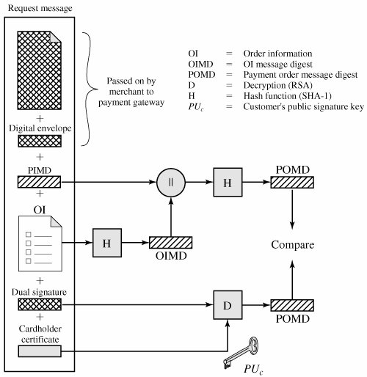
Merchant Verifies Customer Purchase Request

